Slide 1
Paraphrase Generation with Latent Bag of Words
Yao Fu Yansong Feng John P. Cunningham
Presented By:
Fatema Islam Meem
ID: 17301011

Slide 2
Introduction
The generation of paraphrases is a longstanding problem for learning natural language.
Recent neural models primary rely on the sequence-to-sequence (seq2seq) learning framework, achieving inspiring performance gains over the traditional methods.
However, many traditional methods suffer from suboptimal performance.
This paper proposes a latent bag of words (BOW) model for paraphrase generation.
This model provides a optimal performance that maintains and benefits from semantic interpretability.

Slide 3
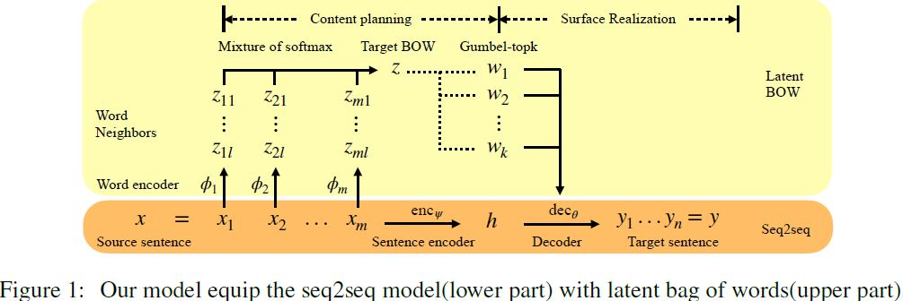
Model
The goal is to extend the seq2seq model (figure 1 lower part) with differentiable content planning and surface realization.
The Sequence to Sequence Base Model: The classical seq2seq model encodes the source sequence x = x₁, x₂, … , x_{m} into a code h, and decodes it to the target sequence y, where m and n are the length of the source and the target, respectively.

Slide 4

Model
Bag of Words for Content Planning: They ground the semantics of a discrete latent variable by the BOW from the target sentences.
Differentiable Subset Sampling with Gumbel Top-k Reparameterization: They used Gumbel top-k reparameterization to perform differentiable subset sampling from the predicted BOW distribution.

Slide 5
Experiments
Datasets and Metrics: They used the Quora6 dataset and the MSCOCO[28] dataset for our experiments.
Baseline Models: We use the seq2seq LSTM with residual connections and attention mechanism as their baseline.

Slide 6
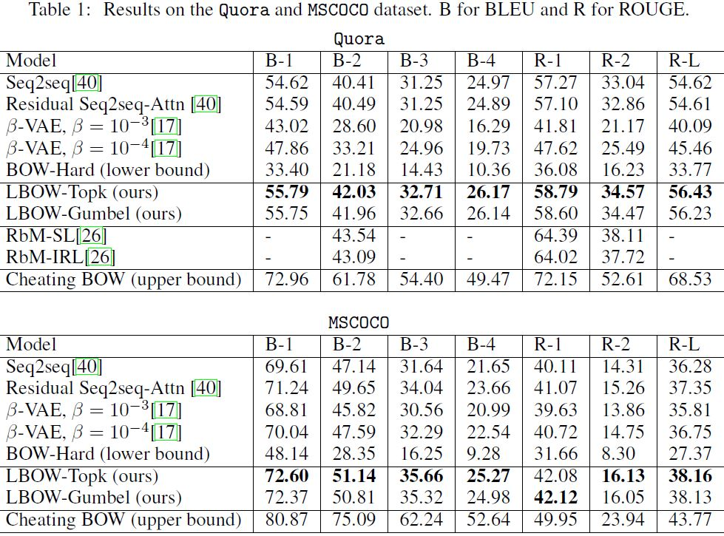
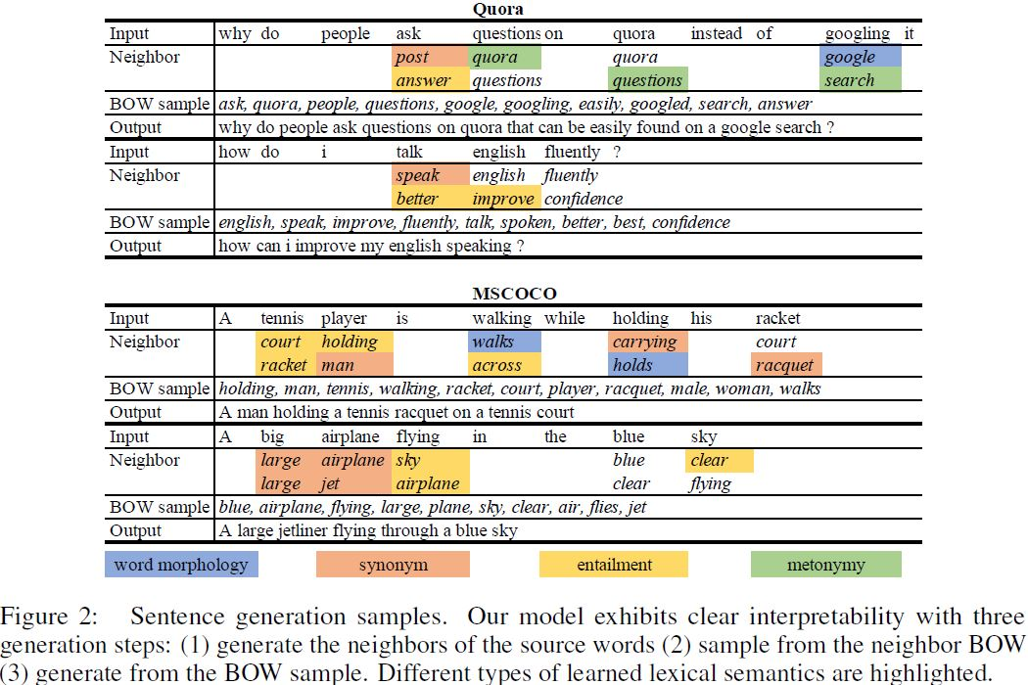
Results
Table 1 show the overall performance of all models. Our models perform the best compared with the baselines.
As highlighted in Figure 2, we notice that the model discovers multiple types of lexical semantics among word neighbors, including:
(1). word morphology
(2). Synonym
(3). Entailment
(4). metonymy9.

Slide 7
Conclusion
The latent BOW model serves as a bridge between the latent variable models and the planning-and realization models. Overall, the step by step generation process serves an move towards more interpretable generative models, and it opens new possibilities of controllable realization through directly injecting lexical information into the middle stages of surface realization.

Slide 8
